Slide 1
An Introduction to
FORMOSAT-3/COSMIC
Speaker: Yi-Fan Chang
Advisor: Prof. Jian-Jiun Ding
2012/12/07

Slide 2
Outline
Introduction
System and Mission Overview
GPS Radio Occultation
Current Status
Data Analysis Discussion
Conclusion
Reference

Slide 3
Outline
Introduction
System and Mission Overview
GPS Radio Occultation
Current Status
Data Analysis Discussion
Conclusion
Reference

Slide 4
Introduction
Name:
  FORMOSAT-3/COSMIC (Constellation Observing System for Meteorology, Ionosphere, and Climate).
Objective:
  Demonstrate the value of near-real-time GPS Radio Occultation(掩星) observations in operational numerical weather prediction.
Major participants:
  UCAR, OSC, NSF, JPL, NRL, AFRL, NSPO

Slide 5
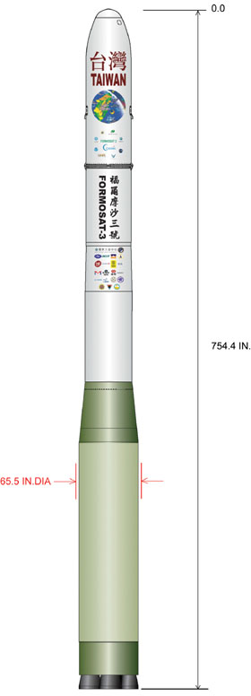
Introduction
Characteristics :
  Number: 6 identical LEO satellites (FM1-FM6)
  Shape: Disc-shaper of 103cm diameter,
  16cm in height
  Weight: 62 Kg (include fuel)
  Design & Mission life: 5 years
  Launch date: 2006/04/15

Slide 6
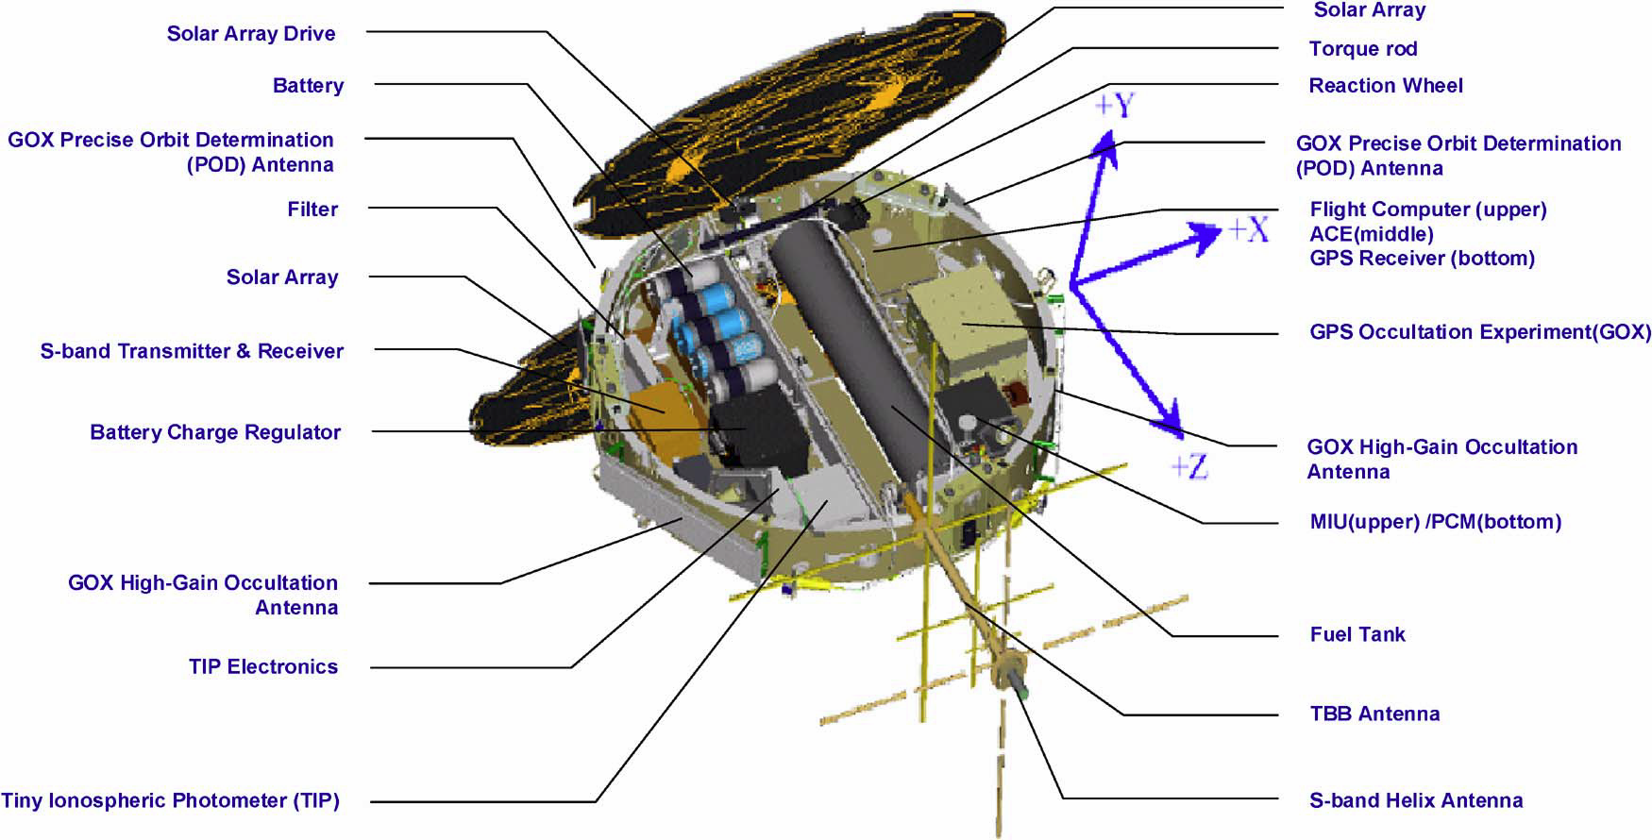
Introduction

Slide 7
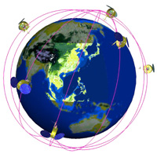
Introduction
Characteristics :
  Orbit: 516 Km -> 700-800 Km (FM3: 711 Km)
  Inclination Angle: 72 degrees
  Argument of Latitude:
  30 degrees apart

Slide 8
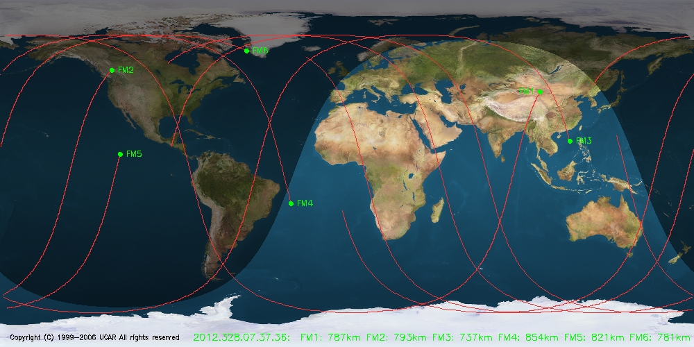
Introduction

Slide 9
Introduction
Provide:
  1500~2000 atmospheric and ionospheric sounding profiles per day
Benefits:
  Increase the accuracy of the predictions of hurricane/typhoon/cyclone behavior.
  Improve long-range weather forecasts.
  Monitor climate change with unprecedented accuracy.

Slide 10
Outline
Introduction
System and Mission Overview
GPS Radio Occultation
Current Status
Data Analysis Discussion
Conclusion
Reference

Slide 11
System and Mission Overview
Three onboard payloads:
  GPS Occultation Receiver (GOX) (GPS掩星接收器)
    4 GPS antenna (POD1, POD2, OCC1, OCC2)
    Receive the signals of L1 and L2-band frequency
  Tri-Band Beacon (TBB) (三頻段信標儀)
    150, 400, 1067 MHz
    High resolution 4-D total electron content
  Tiny Ionospheric Photometer (TIP)
  (小型電離層光度計)
    135.6 nm

Slide 12
System and Mission Overview

Slide 13




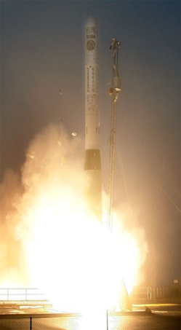


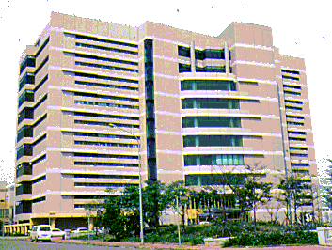





System and Mission Overview
Ground System
FORMOSAT-3
L1&L2
L1&L2
GPS
GPS
Injection Orbit
Payload science data
TBB signal
Command & telemetry
Remote Terminal
Stations (RTS)
Fairbanks, US and Kiruna, Sweden
TBB chains
TT&C, Taiwan
Fiducial
Network
NMC/USN
Multi-Mission Center
(MMC), Taiwan
CDAAC/UCAR
Boulder,CO
TACC/CWB
Taipei
Users
Users

Slide 14
Outline
Introduction
System and Mission Overview
GPS Radio Occultation
Current Status
Data Analysis Discussion
Conclusion
Reference

Slide 15
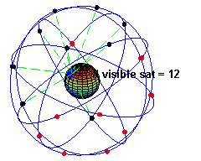
GPS Radio Occultation
GPS system:
  Number: 30 satellites up
  Orbit: 20200 Km
  Each orbit contains at least
  4 satellites
  Needs 4 satellites for 3D positioning
  L1 and L2-band frequency carrier wave
    10.23MHz --> 1.58GHz and 1.23GHz

Slide 16
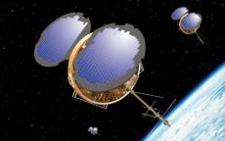
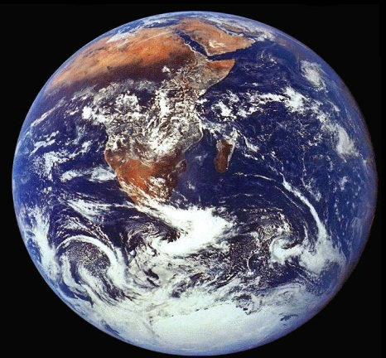
GPS Radio Occultation
GPS Satellite
Radio Wave
Formosat-3/COSMIC Orbit
Formosat-3/COSMIC Satellite

Slide 17
GPS Radio Occultation
α
GPS satellite
LEO satellite
Earth
Neutral atmosphere
Ionosphere

Slide 18
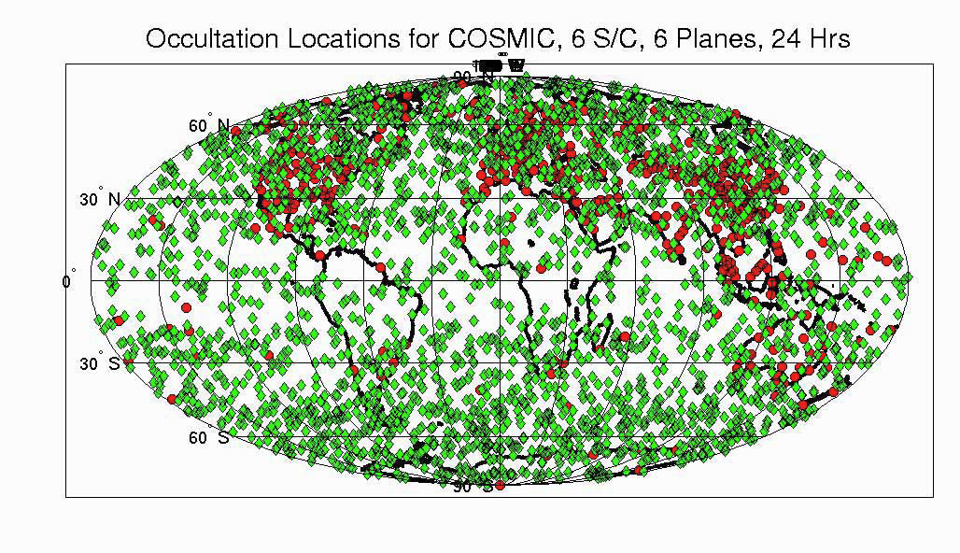
GPS Radio Occultation

Slide 19
Outline
Introduction
System and Mission Overview
GPS Radio Occultation
Current Status
Data Analysis Discussion
Conclusion
Reference

Slide 20
Current Status
Spacecraft | State | GOX | TIP/TBB | Remarks
FM1 | Battery Degradation | POD1 Invalid | OFF | Bad Attitude
FM2 | Power Shortage | POD2 Invalid | OFF | GOX Reboot Loop
FM3 | SADA Stuck In coma since July 6, 2010 | POD1 Invalid | N/A | Sometimes loss of communication 30% Power Remaining
FM4 | Battery Degradation | POD1 Invalid | OFF | GOX Reboot Loop
FM5 | Battery Degradation | POD1 Invalid OCC Low SNR | OFF | GOX Reboot Loop
FM6 | Battery Degradation | POD1 Invalid OCC1 Invalid | OFF | GOX Reboot Loop

Slide 21
Outline
Introduction
System and Mission Overview
GPS Radio Occultation
Current Status
Data Analysis Discussion
Conclusion
Reference

Slide 22
Data Analysis Discussion
Analysis Objects:
  Sun Beta Angle
  Flip-Flop
  Battery Aging Trends
  Reaction Wheels
  SNRs of GOX Payloads
Analysis Methods:
  Hilbert-Huang Transform
  Shot-Time Fourier Transform

Slide 23
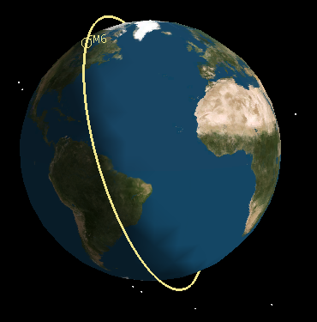
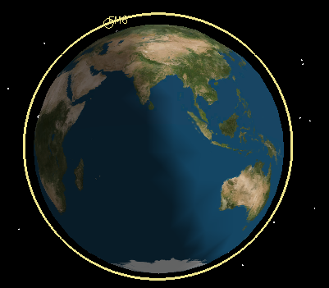
Beta Angle
Sun Beta Angle
Low Beta Angle
(0 degree)
High Beta Angle
(90 degree)
Eclipse Zone

Slide 24
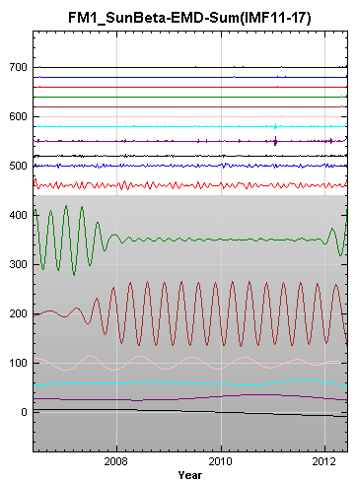
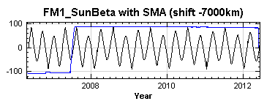
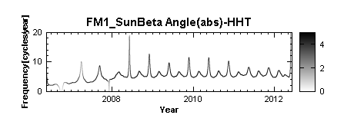
Sun Beta Angle

Slide 25
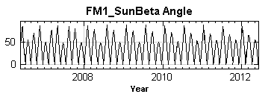
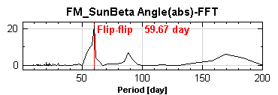
Flip-Flop

Slide 26
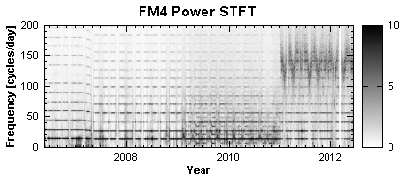
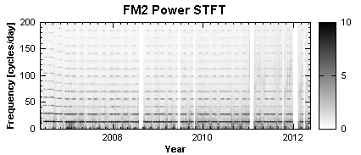
Battery Aging Trends

Slide 27
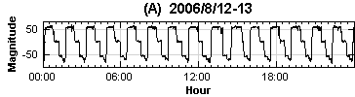
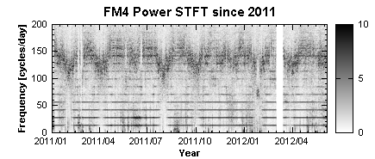
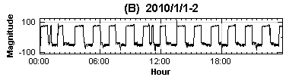
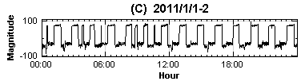
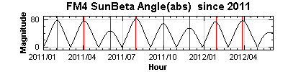
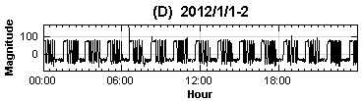
Battery Aging Trends

Slide 28
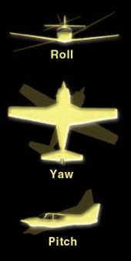
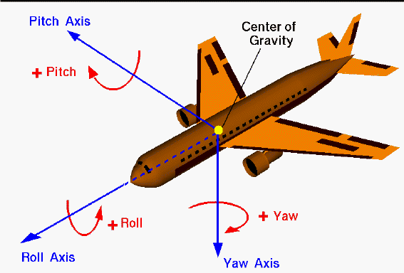
Reaction Wheels

Slide 29
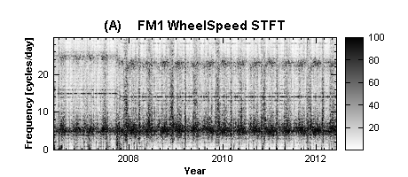
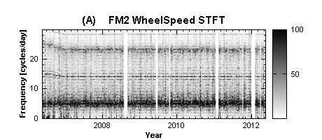
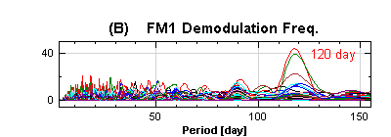
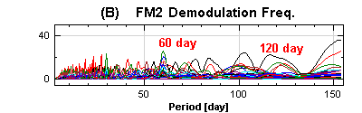
Reaction Wheels

Slide 30
SNRs of GOX Payloads
Anttena 0: POD1
Anttena 1: POD2
Anttena 2: OCC1
Anttena 3: OCC2

Slide 31
Conclusion
The FORMOSAT-3/COSMIC mission initiates a new age for operational GPS-RO soundings for monitoring and forecasting of weather.
The advanced adaptive analysis methods (STFT and HHT) are useful to analyze the trending data.

Slide 32
Reference
[1] C.-J. Fong, S.-K. Yang, C.-H. Chu, C.-Y. Huang, J.-J. Yeh, C.-T. Lin, T.-C. Kuo, T.-Y. Liu, N. Yen, S. S. Chen, Y.-H. Kuo, Y.-A. Liou, and S. Chi, “FORMOSAT-3/COSMIC constellation spacecraft system performance: After One Year in Orbit”, IEEE T. Geosci. Remote, 46(11), 3380–3394, doi:10.1109/TGRS.2008.2005203, 2008b.
[2] C.-J. Fong, D. Whiteley, E. Yang, K. Cook, V. Chu, B. Schreiner, D. Ector, P. Wilczynski, T.-Y. Liu, & N. L. Yen, “Space & Ground Segment Performance of the FORMOSAT-3 / COSMIC Mission: Four Years in Orbit,” Atmospheric Measurement Techniques Journal (AMTJ), Vol. 4, 2011, pp. 1115-1132. Doi:10.5194/amt-4-1115-2011.
[3] Chen-Joe Fong; Yen, N.L.; Chang, G.; Cook, K.L.B.; Wilczynski, P.; , "Future Low Earth observation Radio Occultation mission: From research to operations," Aerospace Conference, 2012 IEEE , vol., no., pp.1-10, 3-10 March 2012
[4] 方振洲、丁建均、王麗豐、顏隆政、楊善國、張明雄、李宗平、王逸民, “適應性分析方法於福衛三號衛星資料之應用,” 中華民國航空太空學會學術研討會, Dec. 2012
[5] National Space Organization: http://www.nspo.narl.org.tw/tw/
[6] Global Positioning System: http://en.wikipedia.org/wiki/Global_Positioning_System

